Slide 1

PROJECT OF PF TIC TAC TOE GAME HUMAN VS COMPUTER
PRESENTED By (JJS):
JAWERIA ASIF
JAVERIA HASSAN
HAFIZA SAMEEN NAZAR

Slide 2
TIC TAC TOE ALGORITHM
These are the following method we use in tic tac toe game.
ALGORITHM
Main method
A.I method
Mark randomly
Flip user
Draw method
Bool check win

Slide 3
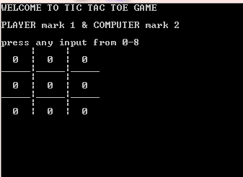
ALGORITHM
GRID of TIC TAC TOE
1 goes first (1 is referred as
HUMAN PLAYER) then 2
( is referred as
COMPUTER INTELLIGENCE).
HUMAN PLAYER puts his 1 into one of the 9 cells. When 2 goes, there are now 8 possible Board Layouts, depending on which Cell has the HUMAN PLAYER mark

Slide 4
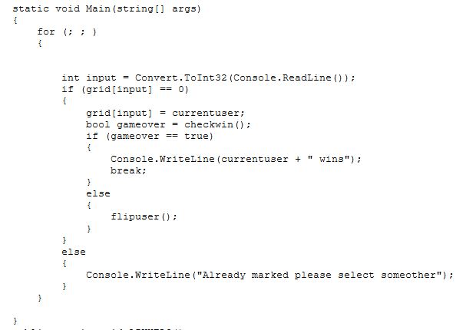
METHOD OF MAIN

Slide 5

INTRODUCTION TO A.I

Slide 6
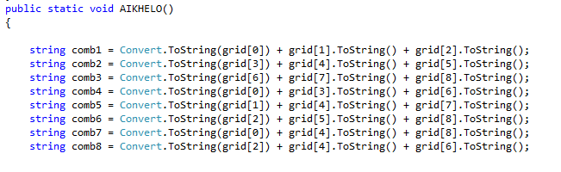
METHOD OF A.I

Slide 7
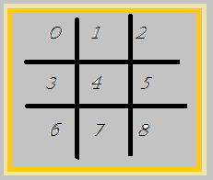
METHOD OF A.I
At first we have make eight basic possible combinations of grid such as :
Then we created the method of A.I by using if and else if and created all the possible combinations which can lead Computer intelligence towards winning point.

Slide 8
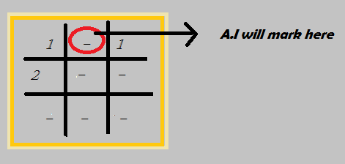
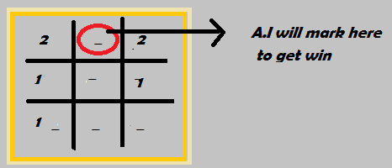
STOP AND WIN METHOD OF A.I
A.I will stop human player
From winning while mark
On the middle.
A.I will check its winning
Condition and mark at the
Position which lead A.I
towards victory.

Slide 9
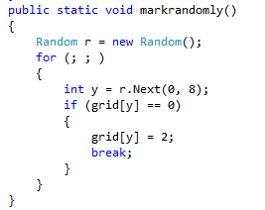
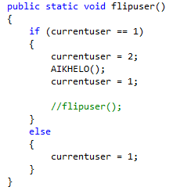
MULTIPLE METHODS
FLIP USER
MARK RANDOMLY

Slide 10
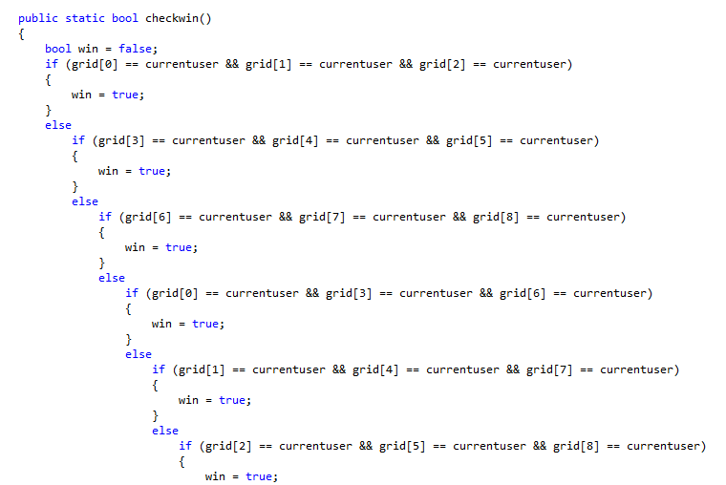
BOOL CHECK WIN METHOD

Slide 11
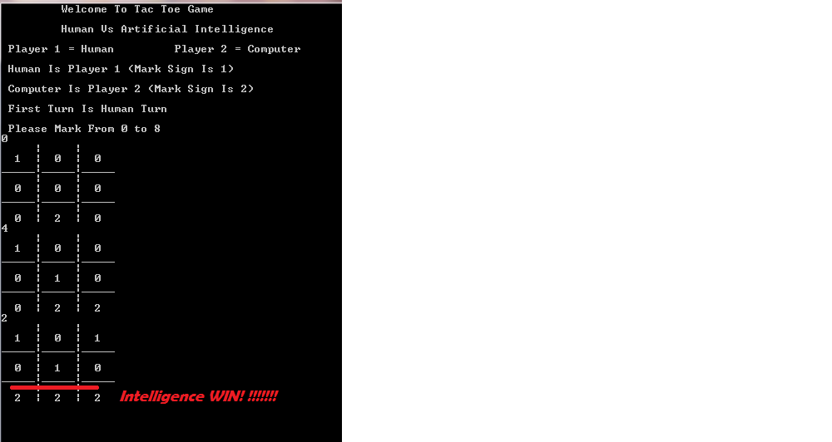
OUTPUT OF OUR PROJECT WINNING CONDITION OF A.I

